Slide 1
Java Basic Syntax
By Asad Hashmi

Slide 2
A simple Program
class MyFirstProgram {
public static void main(String [] args) {
System.out.println(“Hello Java”);
{
int a=10;
System.out.println(a);
}
}
}

Slide 3
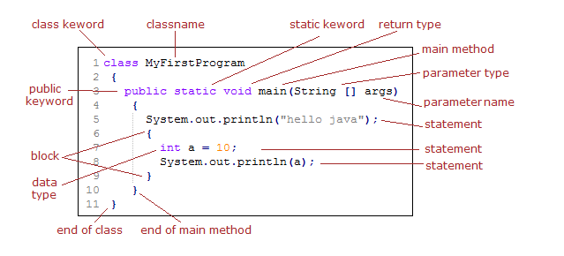
Basic Terms in Java with Example
static - The static is a keyword in java. A method or variable declared with static keyword can be called without creating the object of that class.

Slide 4
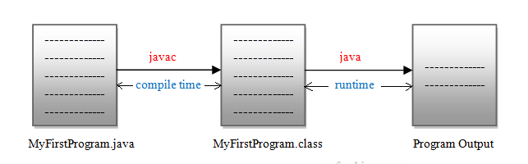
Compile time and runtime in Java

Slide 5
Java Program to Add Two Integers
class test2 {
public static void main(String[] args) {
int first = 10;
int second = 20;
// add two numbers
int sum = first + second;
System.out.println(first + " + " + second + " = " + sum);
}
}

Slide 6

Introduction NetBeans IDE
NetBeans IDE is a free, open source, integrated development environment (IDE) that enables you to develop desktop, mobile and web applications.
The IDE supports application development in various languages, including Java, HTML5, PHP and C++.
The IDE provides integrated support for the complete development cycle, from project creation through debugging, profiling and deployment.
The IDE runs on Windows, Linux, Mac OS X, and other UNIX-based systems.

Slide 7
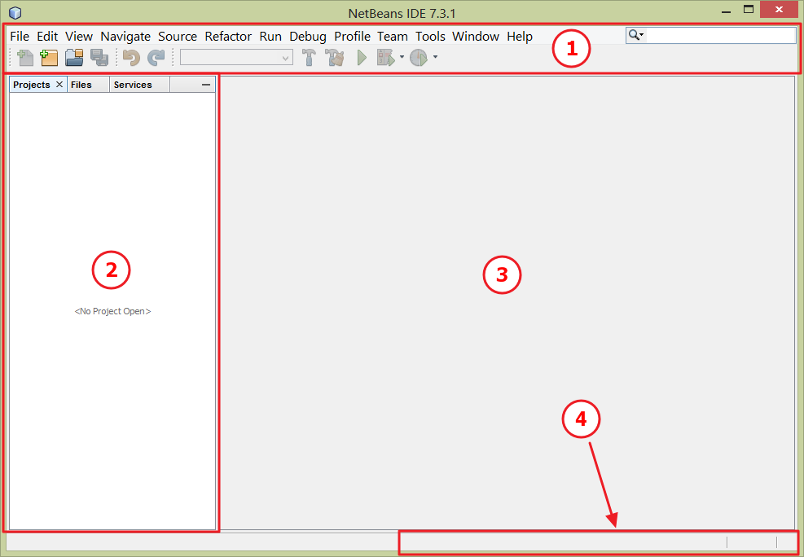
Java programming with NetBeans – NetBeans layout
Complete installation and testing in the linked Video
Control area – [ 1 ]
Reference area – [ 2 ]
Working area – [ 3 ]
Status area – [ 4 ]

Slide 8
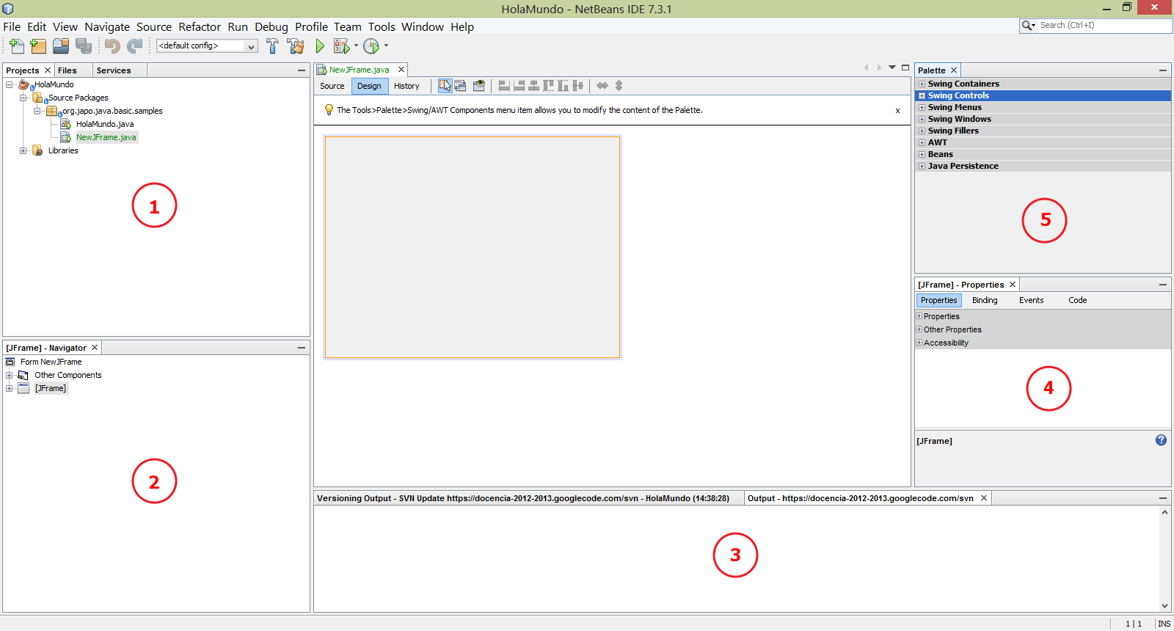

Slide 9
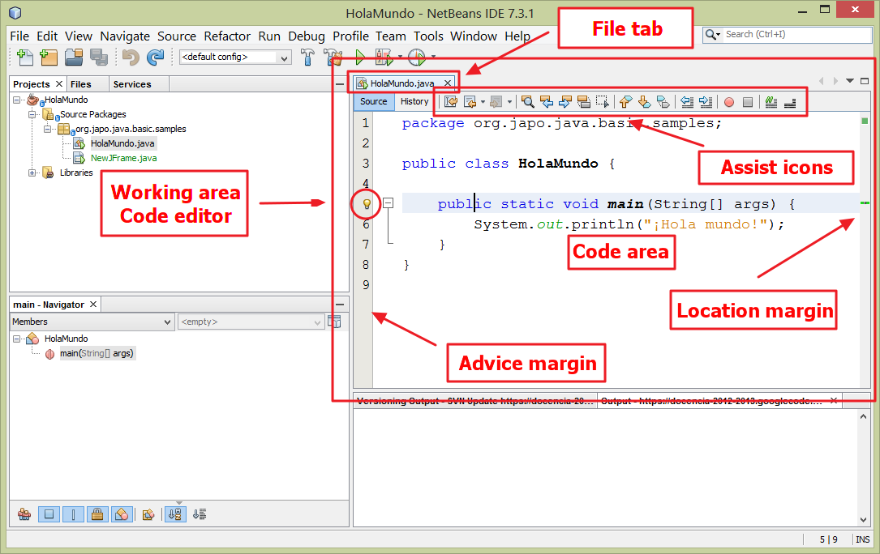

Slide 10
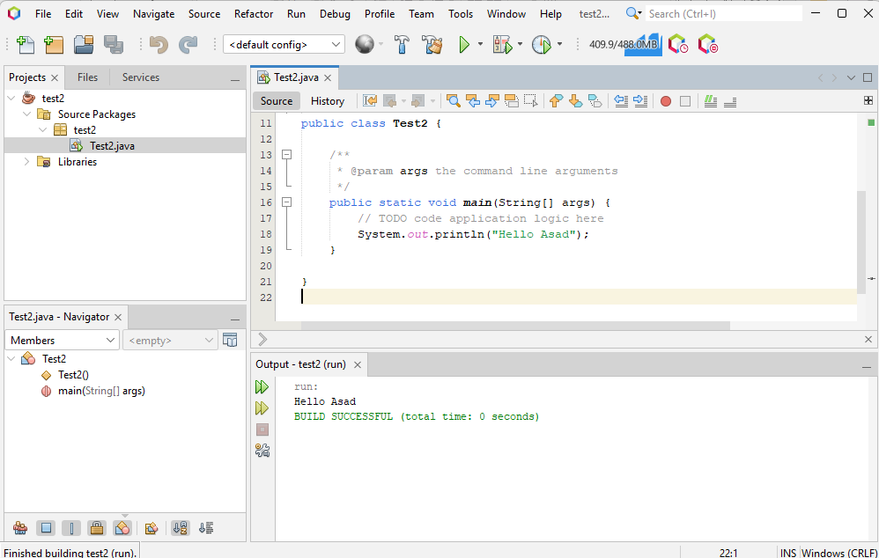
First program in NetBean21

Slide 11
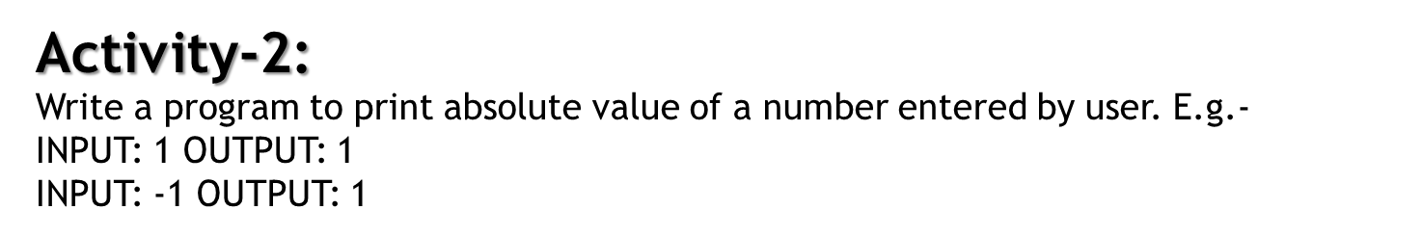
Code
import java.util.Scanner;
class Input {
public static void main(String[] args) {
Scanner input = new Scanner(System.in);
System.out.print("Enter an integer: ");
int number = input.nextInt();
System.out.println("You entered " + number);
// closing the scanner object
input.close();
}
}

Slide 12
